Slide 1
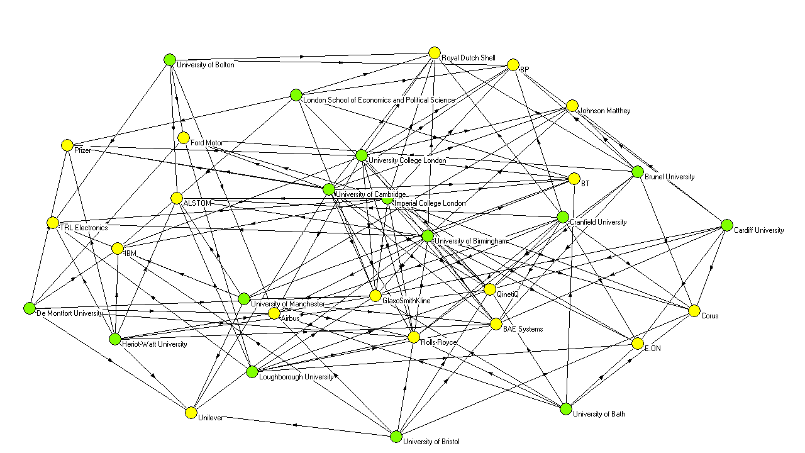
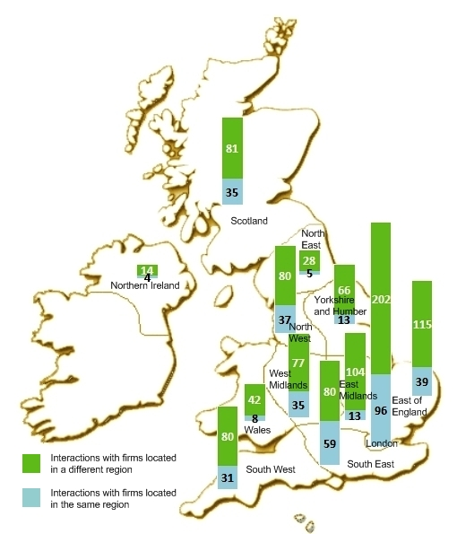
University Knowledge and its Impact on Competitiveness Robert Huggins and Daniel Prokop Centre for International Competitiveness, UWIC, Cardiff
Introduction
This poster presents some of the outputs of the research project on the knowledge of higher education institutions. The key outputs of this research are categorised into themes concerning knowledge networks and distance, and competitiveness.
Methodology
The research employed the collection of data on 158 UK higher education institutions relating to their knowledge transfer activities, constituting a database of nearly 10,000 firms and organisations. The data collected covered the period 2005-2008.
From the data gathered two sets of analysis were performed:
One: concentrated on the survey of UK firms
Two: focused on R&D-intensive firms
The analyses consisted of descriptive statistical analysis, social network analysis, and regression analysis.
Impact on Competitiveness:
UK firms sourcing knowledge overseas are found to show increased levels of innovation and growth. Smaller firms source knowledge less frequently from overseas than larger firms, which reflects financial barriers to knowledge access.
Among industry sectors disparity is noticeable – manufacturing firms being those accessing overseas knowledge more frequently than service firms. This barrier for service firms is related to the different knowledge types they require, with the imbalance being a reflection of global production/supply chain networks of manufacturing firms.
As universities are found to have a substantial economic impact regionally, it is found that interacting with large R&D firms has a significant positive effect on their research revenues.
Figure 2 Cohesive sub-group of university-industry interactions
Conclusions
There is a clear link between university knowledge and its impact on regional competitiveness. Not only do the knowledge networks reveal cross-regional and cross-national characteristics, but also they show that distance does not impede knowledge transfer. For policymakers, this should provide a clue where to direct the efforts and what type of support is necessary. Additionally, the need for universities not to exclude working with large R&D firms from their business support focus is apparent – instead, ensuring a diversity of private industry partners is maintained and not limited to local firms, bringing experience to universities as well as improving their performance. This consequently, provides more diverse knowledge types and sources to businesses.
Acknowledgements
This research has been possible thanks to ESRC (Grant Award Reference: RES-171-25-0023) and NESTA providing financial resources, with the EPSRC supplying useful data. Additionally, the authors would like to express gratitude to all those that participated in different stages of the research: Andrew Johnston, Hiro Izushi, Nick Clifton, Sarah Jenkins, and Chris Whitfield.
Bibliography
Huggins, R., Izushi, H. and Prokop, D. (2010) "University-Industry Networks: Interactions with Large R&D Performers", Proceedings of Opening Up Innovation: Strategy, Organization and Technology – DRUID Conference, 15-18 June, London, UK.
Huggins, R., Izushi, H., Clifton, N., Jenkins, S., Prokop, D. and Whitfield, C. (2010) Sourcing Knowledge for Innovation: The International Dimension, NESTA, London.
Figure 1 Regional map of university interactions
Results
Knowledge Networks and Distance:
The knowledge networks of UK firms involve two-way flows and are often of international character – i.e. businesses source knowledge overseas, with a growing role of sources in developing economies.
Universities more frequently transfer knowledge outside their own regions when they interact with R&D-intensive firms. Furthermore, when they interact with actors in their own regions, especially with the biggest R&D spenders, universities reveal better research income performance.
Those universities and R&D-intensive firms most engaged in knowledge interactions form a cohesive sub-group in the knowledge network, reflecting the strongest knowledge links between industry and academia.

